Slide 1


Programming Logic

Slide 2

Learning Objectives
Understand and implement flow chart diagrams for any given problem.
Write algorithm of any given problem.
Develop problem solving skills
Computer Science Department, UET Lahore.

Slide 3
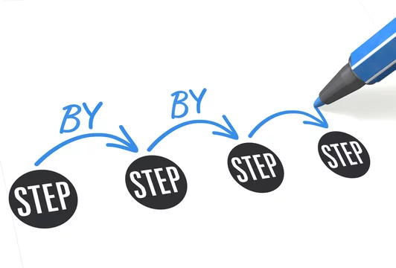
What is an Algorithm?
Algorithm is a finite set of steps which are used to solve a problem.
It is a way to describe the steps you will be following to solve any problem, usually written in pseudocode.
Computer Science Department, UET Lahore.

Slide 4

Why?
To simplify the solution of our problem.
Create a roadmap/flow to carry out each process.
Identify inputs and outputs.
Ease for programming.
Computer Science Department, UET Lahore.

Slide 5
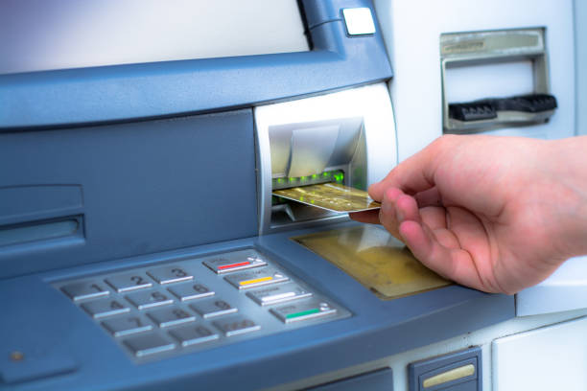
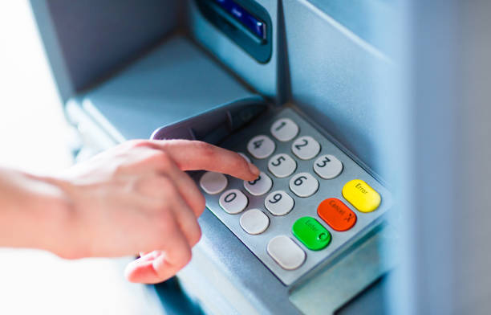
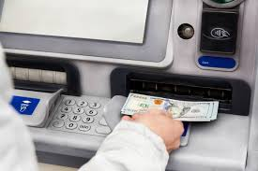
Example
You go through series of steps while making a transaction from an ATM
Insert card
2. Input pin and amount
3. Take money
Computer Science Department, UET Lahore.

Slide 6

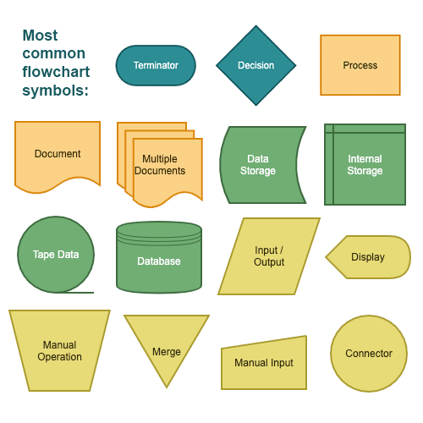
Flowchart
Flowcharts are used to represent the flow of an algorithm.
The steps of the process is shown by boxes and its flow is represented by connecting arrows.
Computer Science Department, UET Lahore.

Slide 7

Flowchart Symbols
Different symbols have different meanings. Some of the common symbols are shown below:
1. The Oval
To represent Start or end of the algorithm.
Computer Science Department, UET Lahore.

Slide 8
Flowchart Symbols
Different symbols have different meanings. Some of the common symbols are shown below:
2. The Rectangle
One step is represented by a rectangle.
Computer Science Department, UET Lahore.

Slide 9
Flowchart Symbols
Different symbols have different meanings. Some of the common symbols are shown below:
3. The Diamond
Used while making some decision.
Computer Science Department, UET Lahore.

Slide 10
Flowchart Symbols
Different symbols have different meanings. Some of the common symbols are shown below:
4. The Arrow
To show the flow of the process
flow
Computer Science Department, UET Lahore.

Slide 11
Flowchart Symbols
Different symbols have different meanings. Some of the common symbols are shown below:
5. The Parallelogram
To represent the input and output
Input
Output
Computer Science Department, UET Lahore.

Slide 12
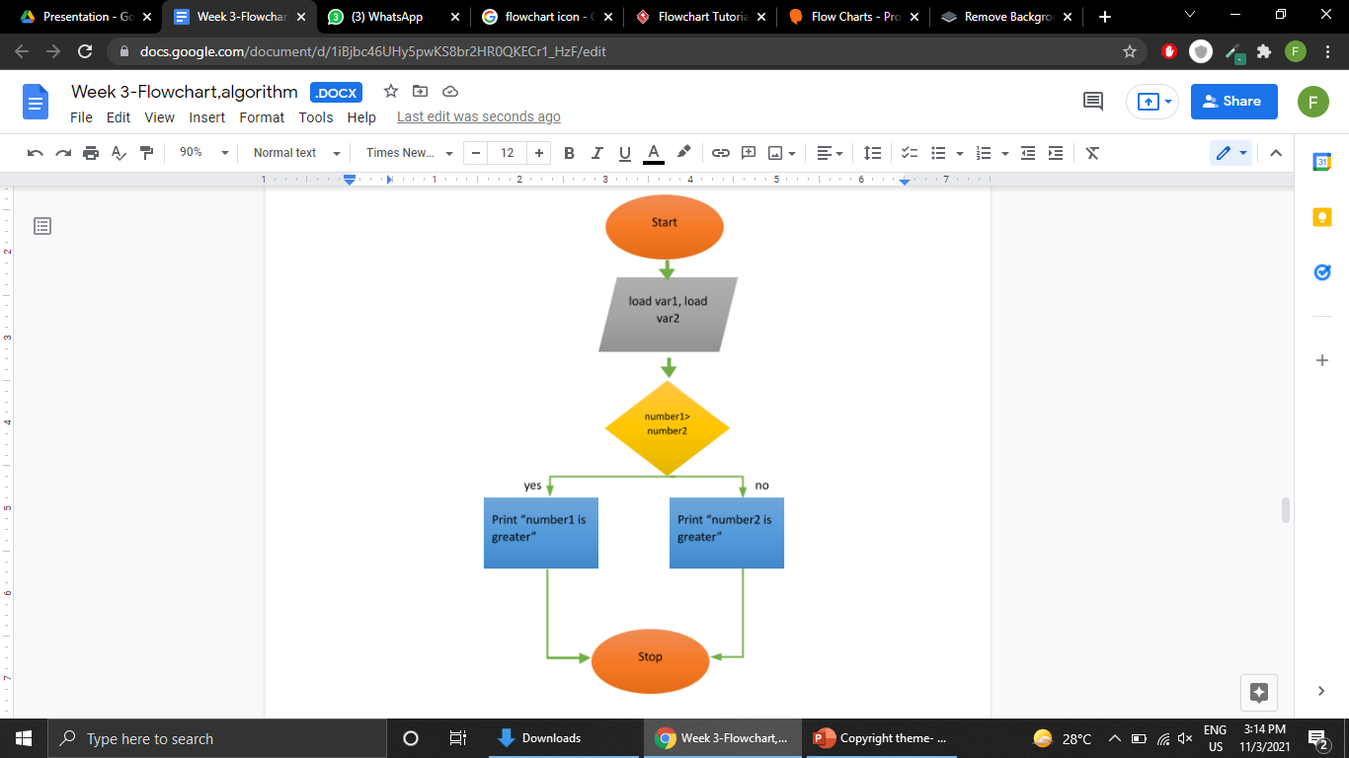
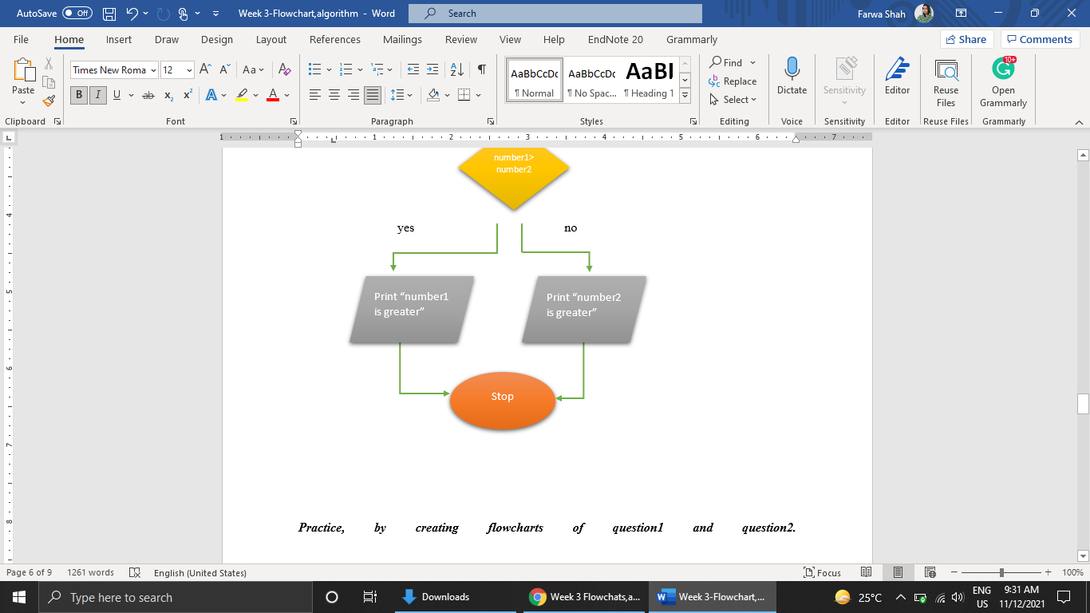
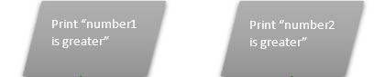
Example
Make a flowchart that takes two values from the user and print the greater number.
Step 1: Start
Step 2: input number1
Step 3: input number2
Step 4: if number1 is greater than number2
Print “number1 is greater”
else
print “number2 is greater”
Step 5: Stop
Computer Science Department, UET Lahore.

Slide 13

Program Structure in Python:
#Some programs discussed in last lecture
variables
num1=5 num2=10
addition=num1+num2
Values assigned to variable
Operation
print(“My first python code”)
Computer Science Department, UET Lahore.

Slide 14
Program Structure in Python:
#Some programs discussed in last lecture
num1=5 num2=10
addition=num1+num2
print(“Hello World”)
Function to display content on console
Computer Science Department, UET Lahore.

Slide 15
Activity
1. Write an algorithm of your admission process in UET
2. Make a flowchart for this process.
3. Write a code that takes five number as input from user.
Print the numbers
Find mean and print it as well.
Computer Science Department, UET Lahore.
Notes:
Something about high and low level languages.

Slide 16
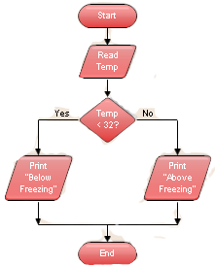
Activity
1. Write an algorithm and code from the given flowchart
Computer Science Department, UET Lahore.
Notes:
Something about high and low level languages.

Slide 17

Learning Objective
In this lecture, we learned about algorithm designing, making flowcharts, meaning of different shapes in flowcharts, and writing programs in python.
Computer Science Department, UET Lahore.

Slide 18

Conclusion
Algorithms help us in solving problems by creating different steps.
Algorithms are not programming codes.
Flowcharts are used to represent each step of a process in the form of blocks.
Every shape has different meaning in flowcharts.
In python,the program contains variables, functions and operations.
Computer Science Department, UET Lahore.

Slide 19

Take Home Tasks
1. Find out about different writing styles of algorithms
2. Find out about different shapes of flowcharts and their usage.
3. Maria has 4 bags while going to airport, she has been told that she can take an average of 50kg.Tell her to input the weights of each bag and calculate the mean weight.
Computer Science Department, UET Lahore.

